Slide 1




ANOMALY DETECTION IN TEXTS USING GRAPH-BASED METHODS
Leveraging Graph Fourier Transform and Laplacian
Student :Alexander Kovtonyuk
Supervisor: Prof. Zeev Volkovich

Slide 2

TABLE OF CONTENTS
Introduction
Proposed approach
Background
Process
Verification Plan

Slide 3
INTRODUCTION
Anomaly Detection
The process of identifying unusual or unexpected patterns in data that deviate from the norm.
In textual data, anomalies could indicate errors, fraudulent information, or other irregularities.
Anomaly Detection Importance in Textual data
Ensures data integrity and reliability.
Detects critical issues like misinformation, fraud, or compliance violations.

Slide 4

THE PROBLEM
CHALLENGES IN TEXTUAL ANOMALY DETECTION
Complexity of Language:
Text is highly variable, with complex semantics (meaning) and syntax (structure).
Difficulties in understanding context, nuances, and multiple meanings of words.
High Dimensionality:
Text data often contains many features (words, phrases, etc.), making it challenging to analyze.
This makes it difficult for traditional methods to detect subtle deviations from normal patterns.

Slide 5
TRADITIONAL ANOMALY DETECTION METHODS
LIMITATIONS OF TRADITIONAL METHODS
Statistical Models:
Tend to oversimplify the complex relationships within the text, assuming a fixed distribution that doesn't reflect real-world language use.
Machine Learning Models:
Struggle to effectively capture the deep semantic (meaning) and syntactic (structure) patterns of text data.
Deep Learning Models:
Require significant computational resources and extensive labeled datasets.
Due to their high computational cost, deep learning models can be impractical for many real-world scenarios, especially those with limited resources.

Slide 6
PROPOSED APPROACH
GRAPH-BASED METHOD
Represent textual data as a graph where:
Nodes: Text units (e.g., sentences, paragraphs).
Edges: Represent semantic and syntactic relationships between text units.
Analyzing Relationships:
Application of spectral graph analysis to the text graph, using mathematical transformations to decompose the relationships between text units.
Anomaly Detection Using Frequency Analysis:
Using frequency-based analysis, we will identify anomalies by examining parts of the text graph that exhibit irregular or high-frequency patterns, indicating unusual or unexpected text behaviors.

Slide 7
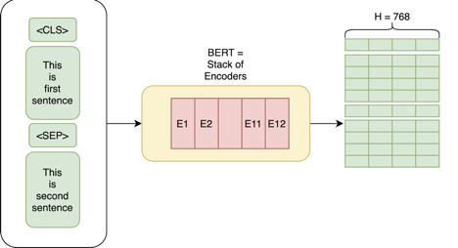
BACKGROUND
BERT LANGUAGE MODEL
BERT LANGUAGE MODEL:
A transformer-based model developed by Google, designed for natural language processing tasks. It reads text bidirectionally, meaning it captures context from both the left and right of a given word or phrase.
Contextual Understanding: BERT generates embeddings that consider the context of a word within a sentence, unlike traditional models that treat each word independently.

Slide 8
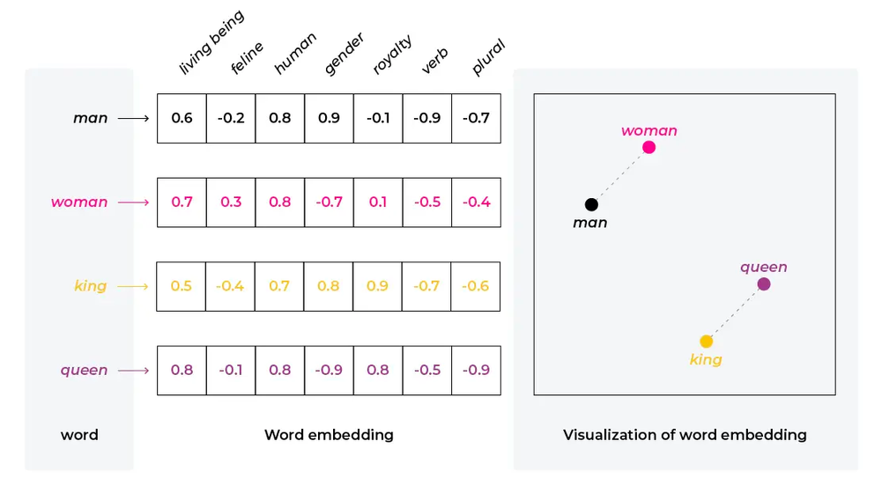
BACKGROUND
FEATURE EXTRACTION AND EMBEDDINGS
Embeddings in Text Analysis:
Embeddings are numerical representations of text, where words, sentences, or paragraphs are converted into dense vectors of fixed size.
Feature Extraction:
Feature extraction is the process of converting raw data (such as text) into a set of measurable characteristics or vectors that machine learning models can use.

Slide 9
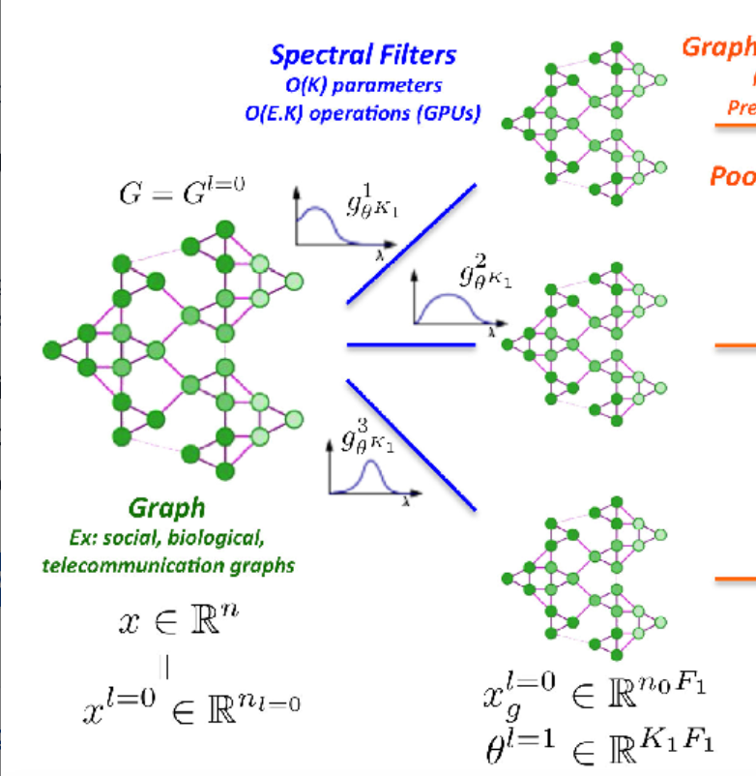
BACKGROUND
SPECTRAL GRAPH THEORY
Spectral Graph Theory:
Study of graph properties using eigenvalues and eigenvectors of matrices (like the adjacency or Laplacian matrix).
Supports in understanding graph structures (e.g., clusters, connectivity) and detecting anomalies by examining spectral properties.

Slide 10
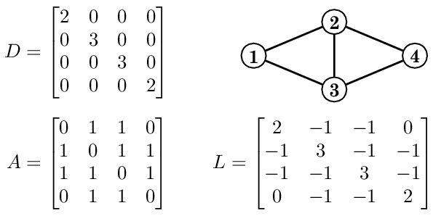
BACKGROUND
LAPLACIAN MATRIX
Laplacian Matrix:
The Laplacian matrix L of a graph is a key matrix that captures the structure of a graph by reflecting how nodes are connected.
Defined as:
D is the degree matrix, a diagonal matrix where each element represents the degree of a node.
A is the adjacency matrix, which represents the connections between nodes.
L=D−A

Slide 11
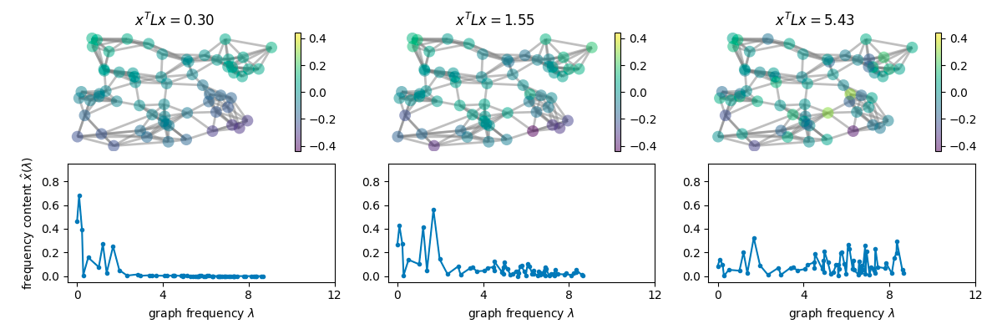
BACKGROUND
GRAPH FOURIER TRANSFORM
Graph Fourier Transform (GFT):
GFT leverages eigenvectors of the Graph Laplacian to transform graph signals into the frequency domain.
Decomposes the signal into frequency components, where high-frequency components often indicate anomalies or irregular patterns in data.

Slide 12
ENGINEERING PROCESS
TEXT PREPROCESSING
Data Preprocessing:
Tokenization: Split the text into smaller units, such as sentences or paragraphs.
Feature Extraction:
Use BERT to convert each tokenized sentence​ into a high-dimensional embedding​.
Cosine Similarity:
Use the embeddings vectors to calculate relationships between text units, forming the basis of graph edges.

Slide 13
ENGINEERING PROCESS
GRAPH ANALYZE
Computing the Graph Laplacian:
Compute the Laplacian Matrix L after computing the Degree matrix and Weight Matrix
Graph Fourier Transform (GFT):
Perform eigen decomposition of the Laplacian matrix to get eigenvalues and eigenvectors .
Transform the graph signal into the frequency domain.
Analyzing High-Frequency Components:
The anomaly score is determined by analyzing high frequency components of the graph’s signal.
Nodes with scores exceeding the determined threshold are flagged as anomalies.

Slide 14
ENGINEERING PROCESS
MATERIAL
Books:
We will use a collection of books from both classic literature and modern publications, We will stimulate and plant anomalies in it to evaluate how well the system identifies these anomalies.
Academic articles and Journals:
Texts from academic sources such as scientific papers, journals and articles. These texts tend to have more formal structure, making them useful for analyzing language use in more technical context.

Slide 15
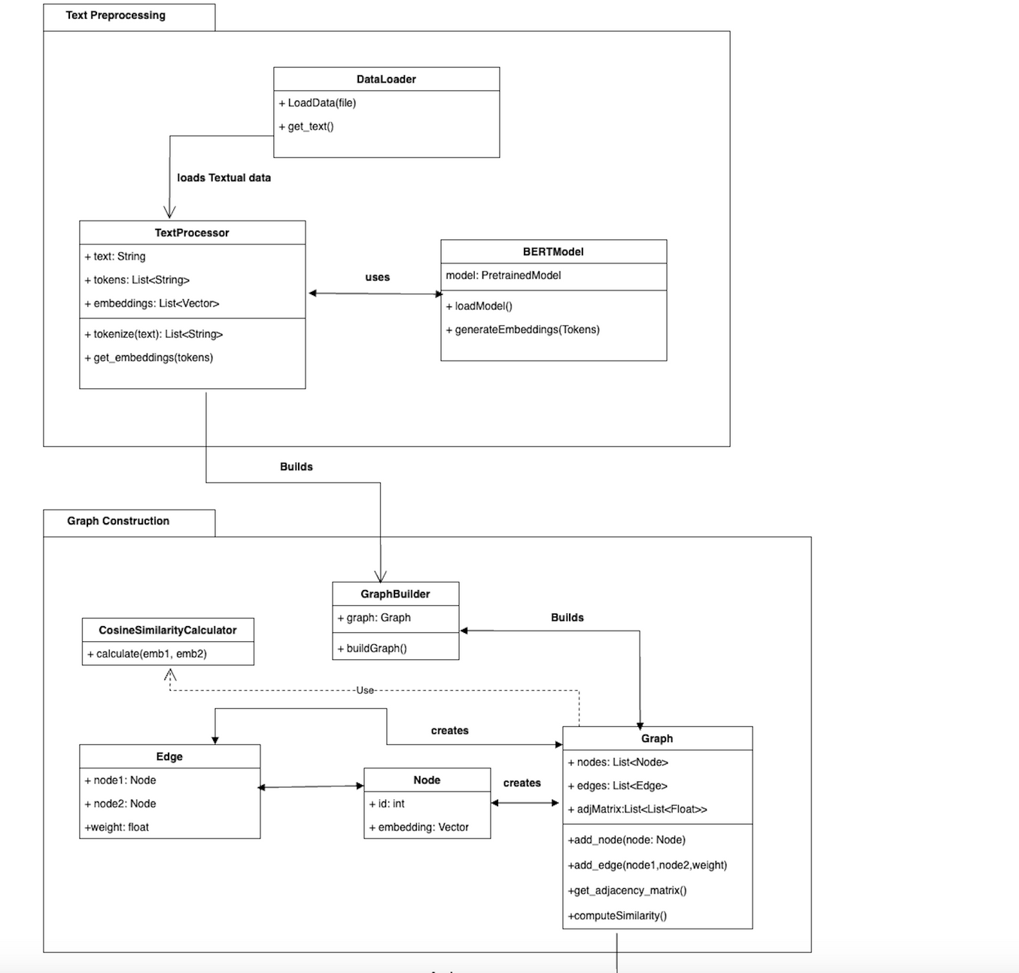
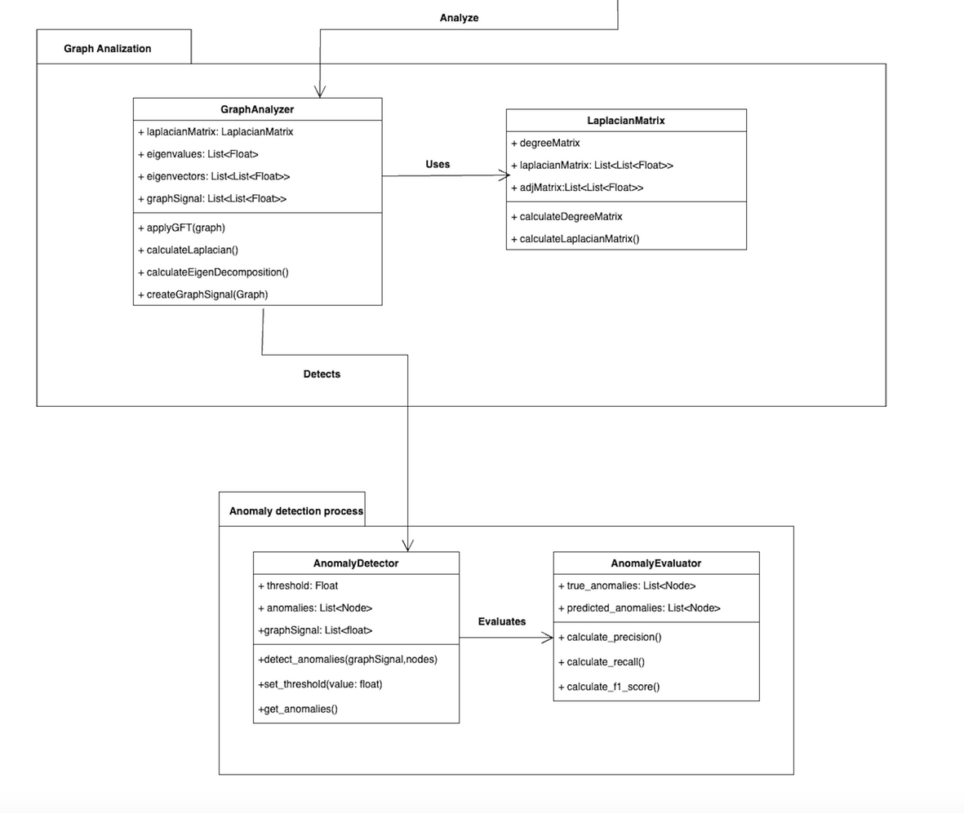
PRODUCT DIAGRAM

Slide 16
EXPECTED RESULTS
Accurate Anomaly Detection:
We expect the model to identify irregular text patterns that deviate significantly from the normal data.
Effective Graph Representation:
The graph-based approach is expected to capture both semantic and syntactic relationships between text units, leading to meaningful insights into the data structure.
High Precision and Recall:
The system should achieve high precision, minimizing false positives, and high recall, capturing most true anomalies.

Slide 17
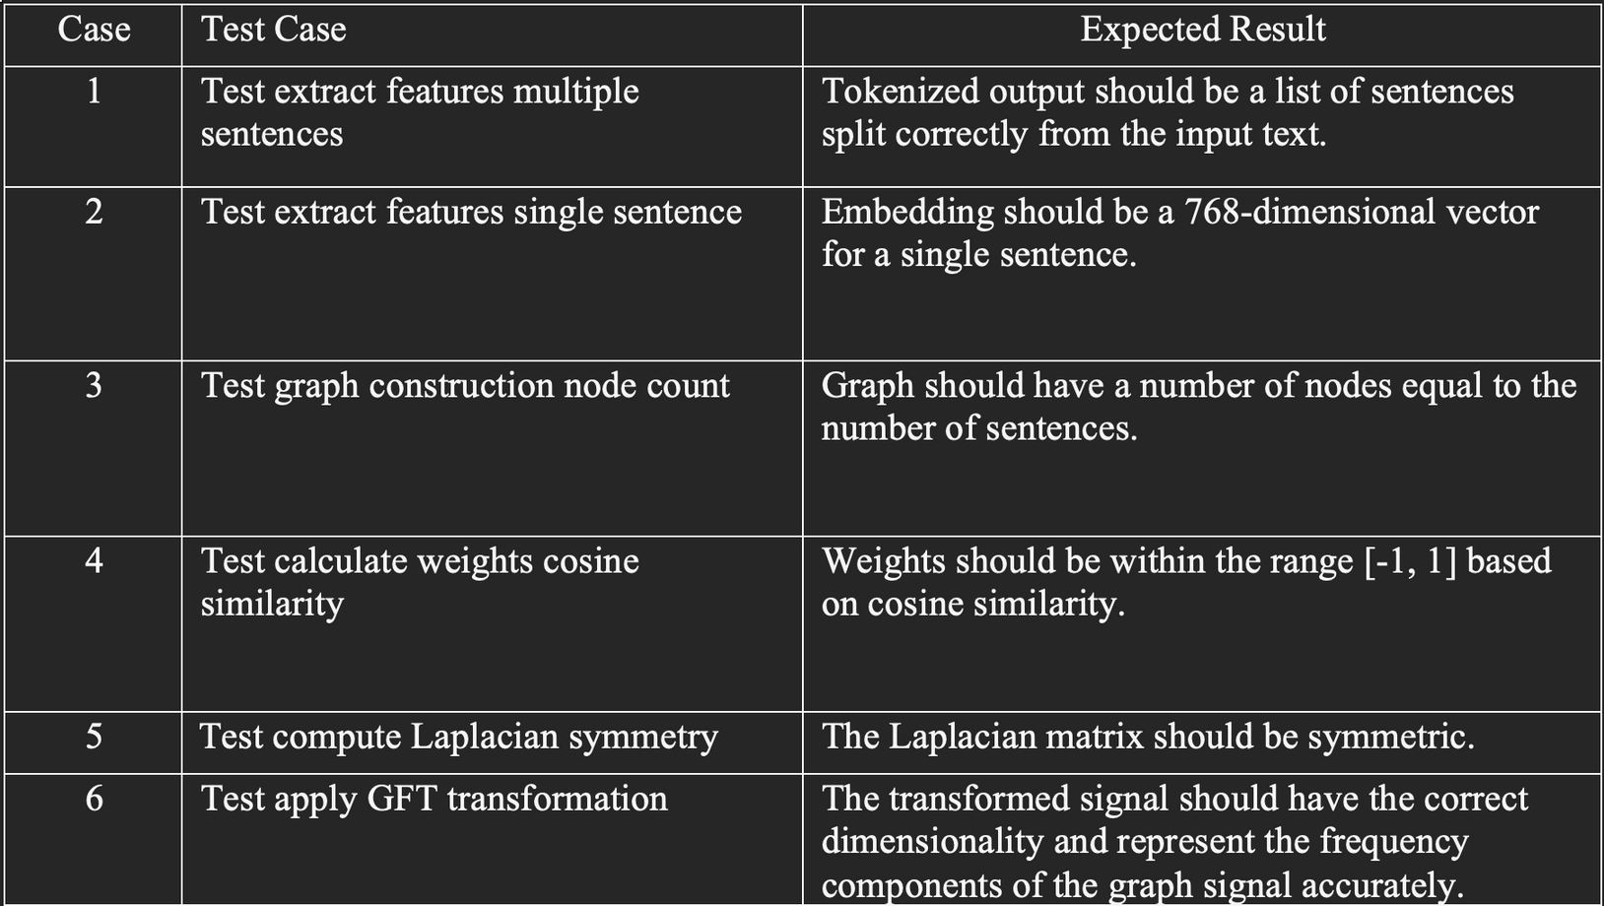
VERIFICATION PLAN

Slide 18
Thank You
For your attention

